Slide 1
ANALYSIS OF CLIMATE CHANGE IMPACT TO GLOBAL WINE PRODUCTION

Slide 2
UCB Data Bootcamp Project 1
June 17th, 2024
Brenda M., Theresa F., Rinal S., Jeff K., Madison O.
https://github.com/omomadcat/Viticulture

Slide 3

Research questions
Which were the top wine producing countries in year 1995?
Which are the current top wine producing countries in year 2003?
What is the correlation between temperature and wine production?

Slide 4
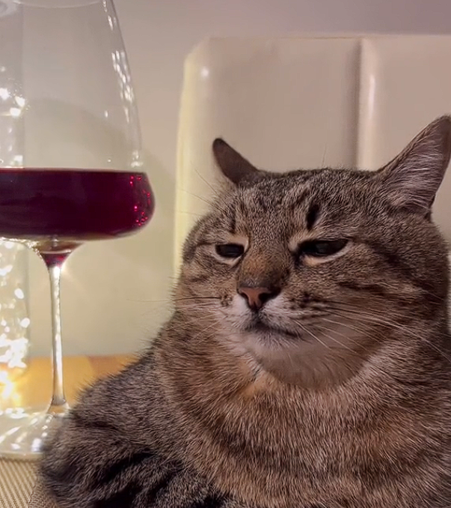
Research questions cont.
4. What is the correlation between precipitation and wine production?
5. What is the optimal temperature for maximum production?
6. What is the optimal precipitation level for maximum wine production?
7. For which countries has the climate changed to favorably or unfavorably impact wine production?

Slide 5
DATASETS
International Organization of Vine and Wine
Statistics https://www.oiv.int/what-we-do/statistics
Database Discovery Tool https://www.oiv.int/what-we-do/data-discovery-report?oiv
NOAA National Centers for Environmental Information
Data access https://www.ncei.noaa.gov/access
NCEI Data Service API User Documentation https://www.ncei.noaa.gov/support/access-data-service-api-user-documentation
Climate Data Online: Web Services Documentation https://www.ncdc.noaa.gov/cdo-web/webservices/v2#gettingStarted

Slide 6








Data Extraction / Cleaning
Extraction | Cleaning
Excel
Wine Data
csv
mapping
Cleaned file
Python
Climate Data
merge
Cleaned file
API
csv
mapping
preparation
Cleaned file
Python
6
preparation
Dataframe/Starter Code

Slide 7
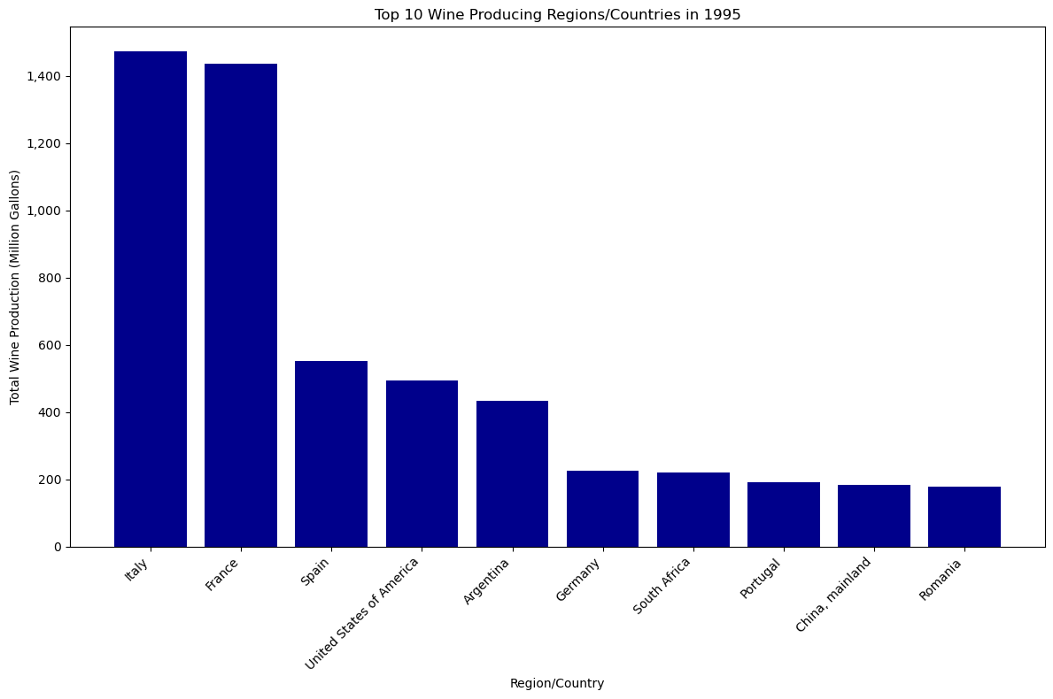
Global wine production stats questions
Top wine producing countries in 1995

Slide 8
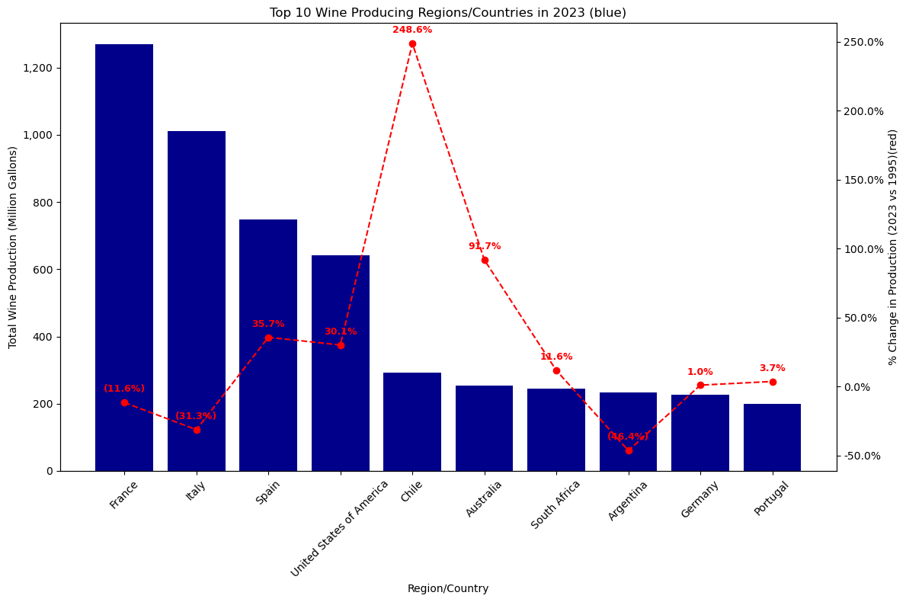
Global wine production stats questions
Top wine producing countries in 2023

Slide 9
Work
Cleaned up wine_data_all_2.csv to match country names with weather data
NOAA weather data used FIPS-10 system of country codes. I prepared the fips-countries.csv
To observe weather affects on wine production created plots to observe affect on production per different parameters like PRCP, TMAX, EMXT, etc.
Plotted correlation between TMAX and Wine production taking France as an example.
The correlation is calculated using the lingress function
The lines and slopes show that production falls as temperature rises

Slide 10
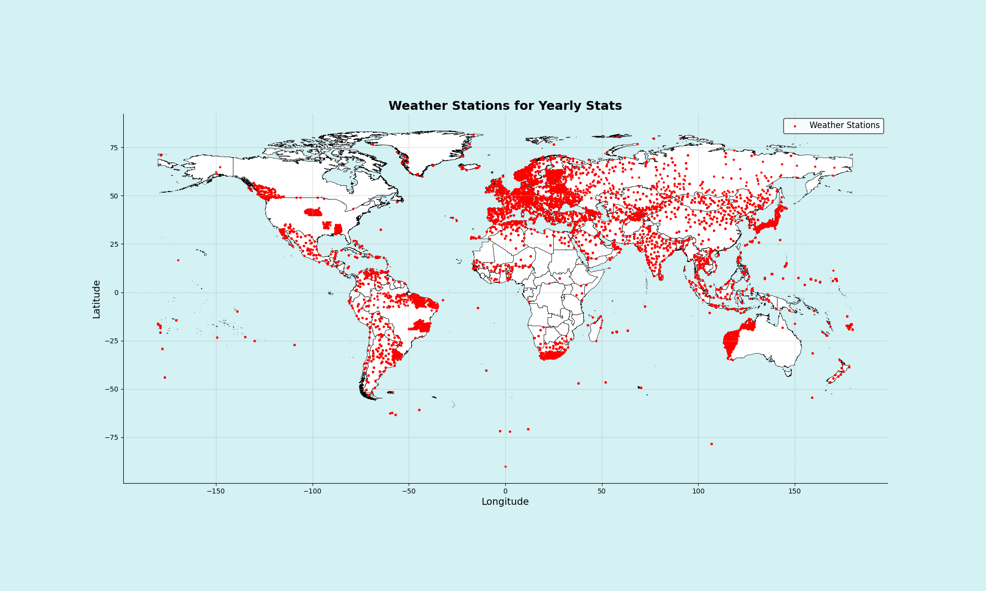
[INSERT]
…

Slide 11
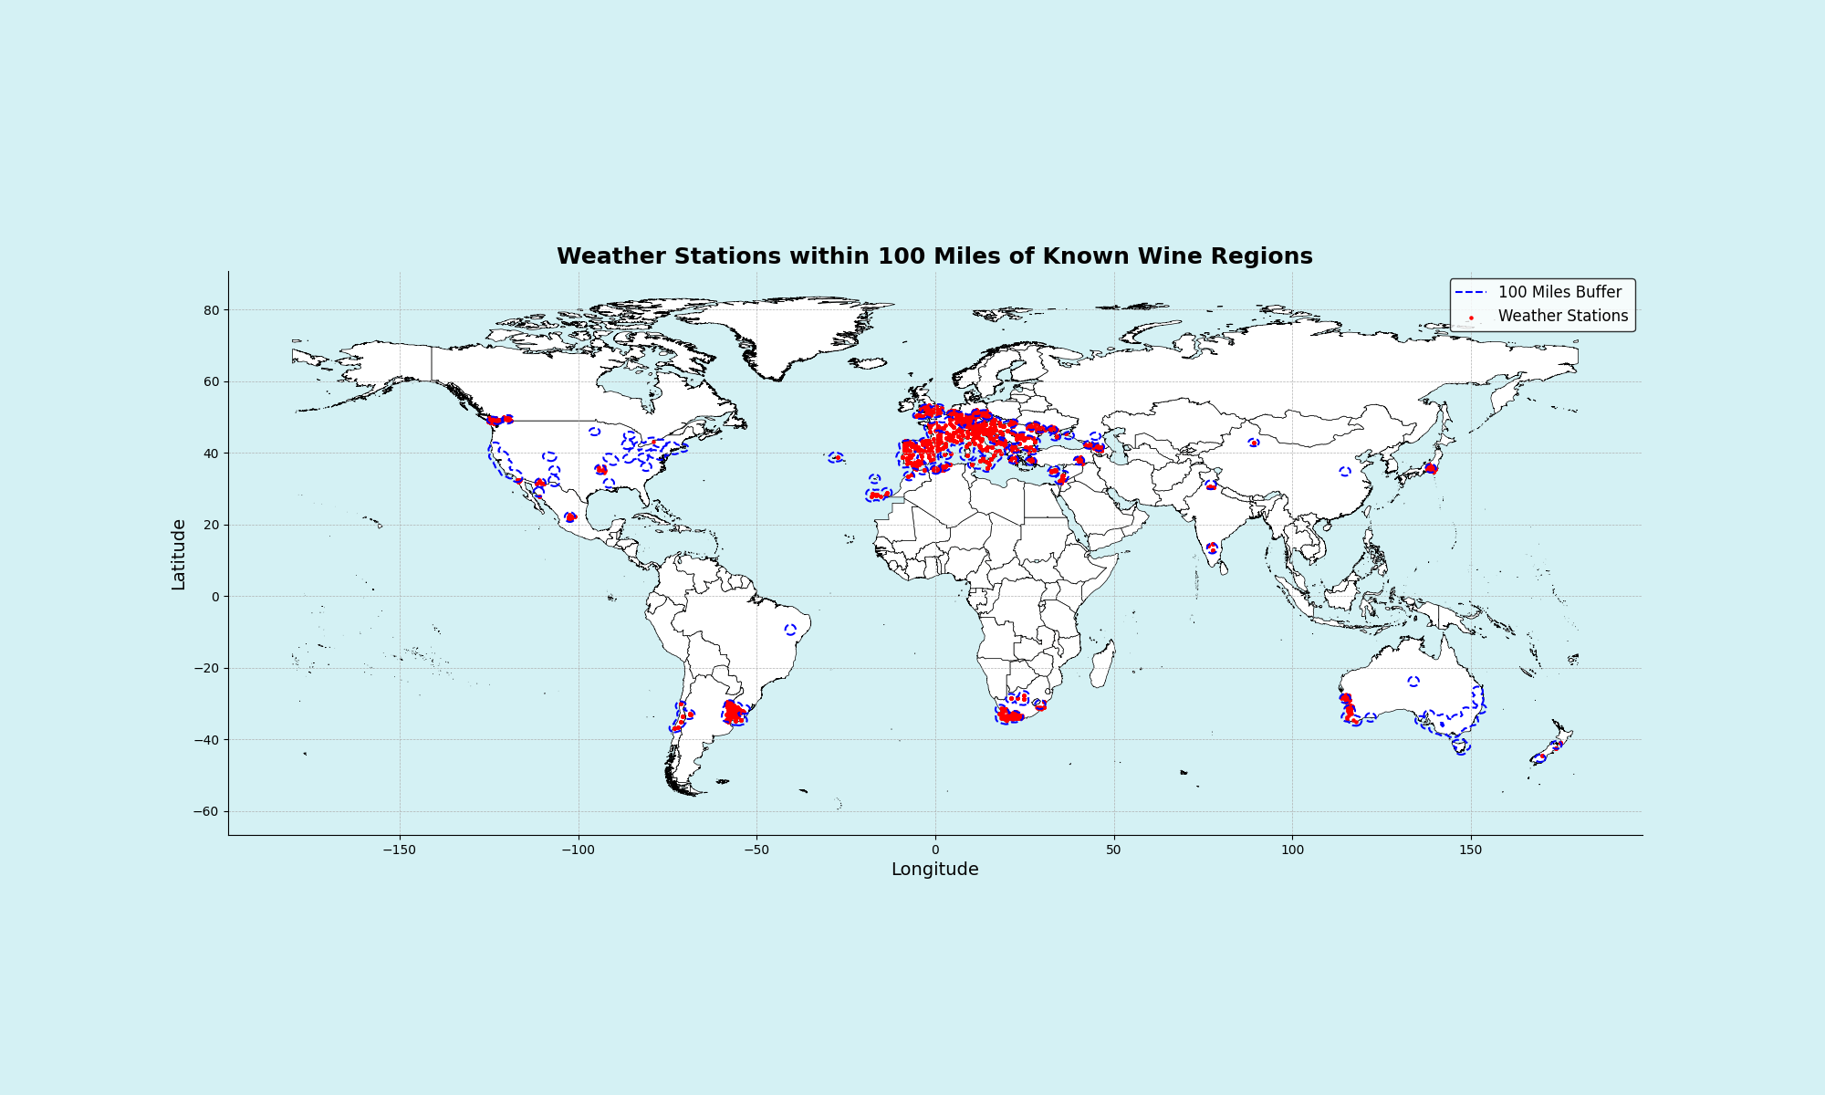
[INSERT]
…

Slide 12
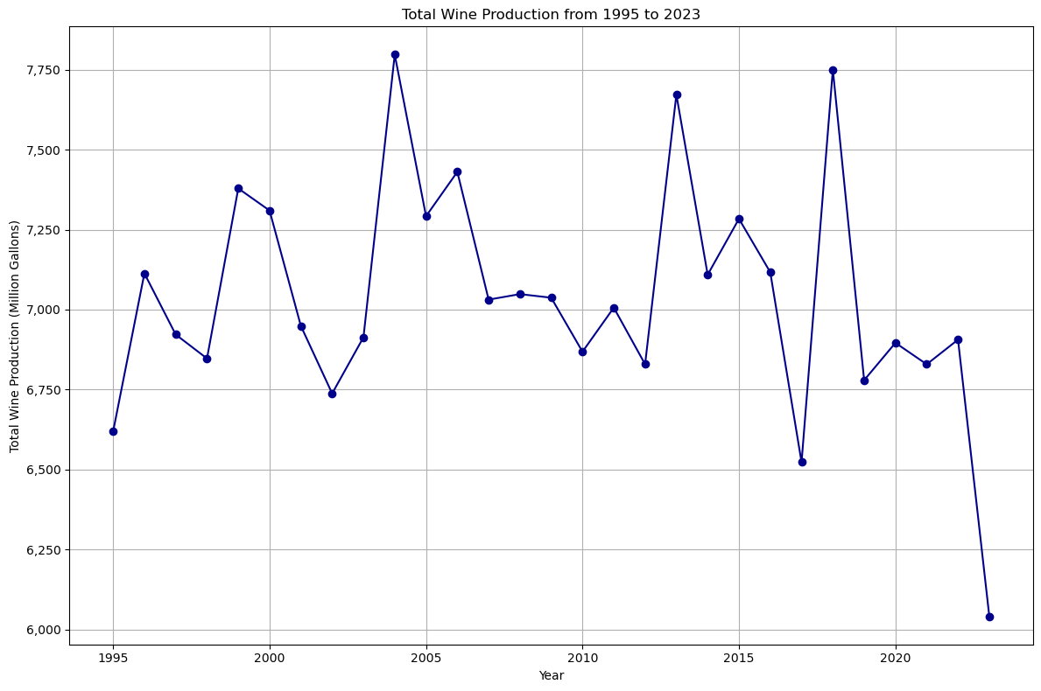
Global wine production stats questions
Climate has a direct influence on grape crop development and the final yield. Hence why this analysis focused solely on climatic factors and their change over time.
Analysis range for total global wine production 1995 – 2023.
1995: ~6,000 million gallons
2023: ~4,000 million gallons

Slide 13
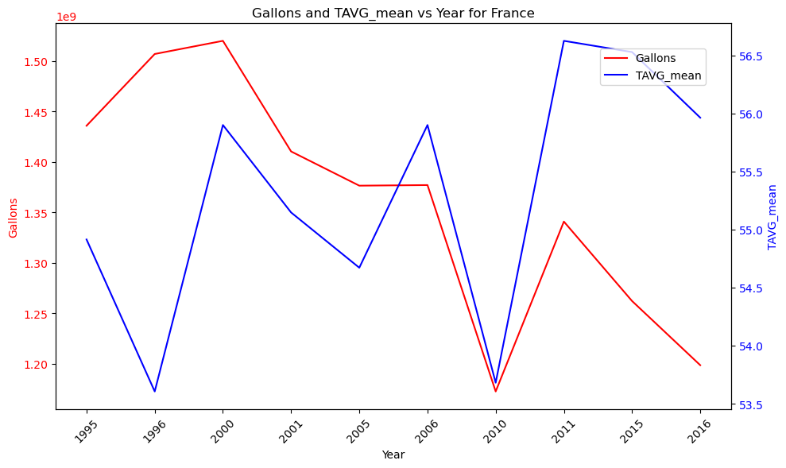
Changes in wine production per weather Taking France as an example
Average Temperature
Notes:
Data clean up was very important. We had 3 data tables:
Weather – Containing weather information per country codes per year from NOAA
Wine production data – per year according to country names
FIPS country codes
The country names in weather data had lot of spaces and spellings different from weather and country codes
NOAA used FIPS 10 system
Weather analysis
NOAA gave all data in the same columns. Had to use pivot table to get them into columns
Each country had multiple weather stations
I calculated mean of all weather stations per country to get overall sense of weather in that country
Filtered out the empty values where data was absent
Plotted temperature and Production data over multiple years
This graph shows how average temperature affects Wine production over the years

Slide 14
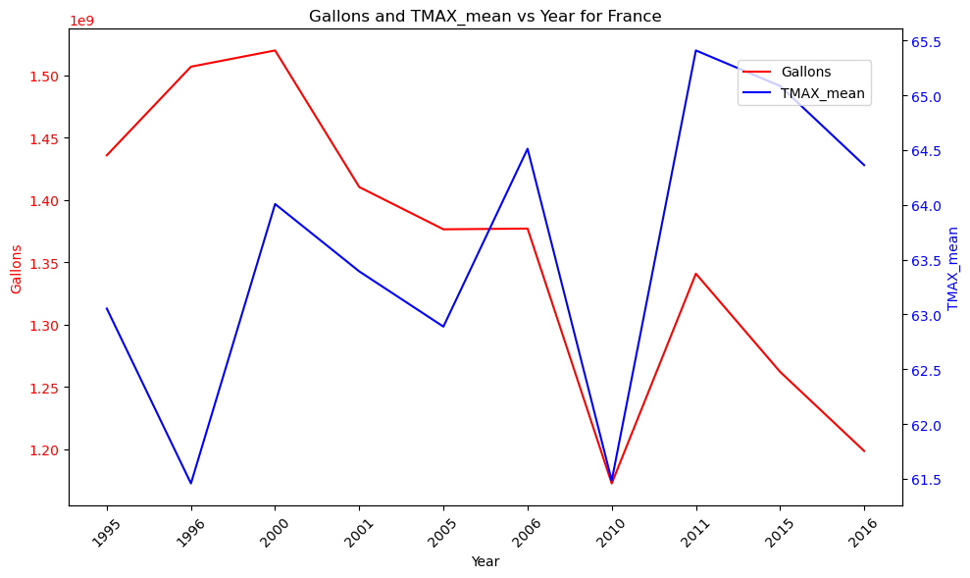
Changes in wine production per weather
Max Temperature
Notes:
This graph shows how Max temperature affects Wine production over the years

Slide 15
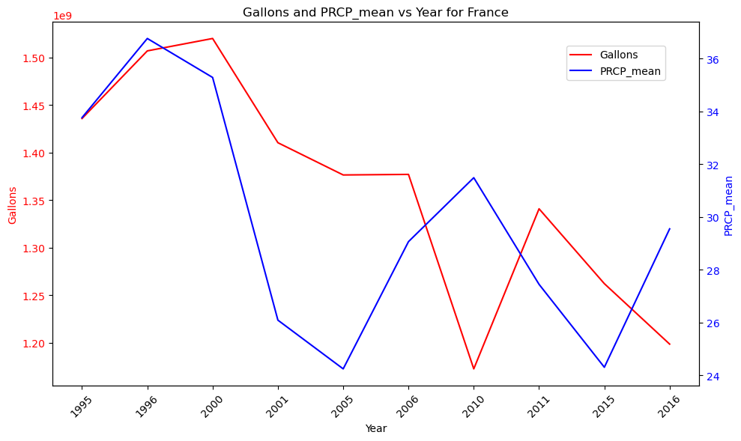
Changes in wine production per weather
Precipitation
Notes:
This graph shows how Precipitation affects Wine production over the years

Slide 16
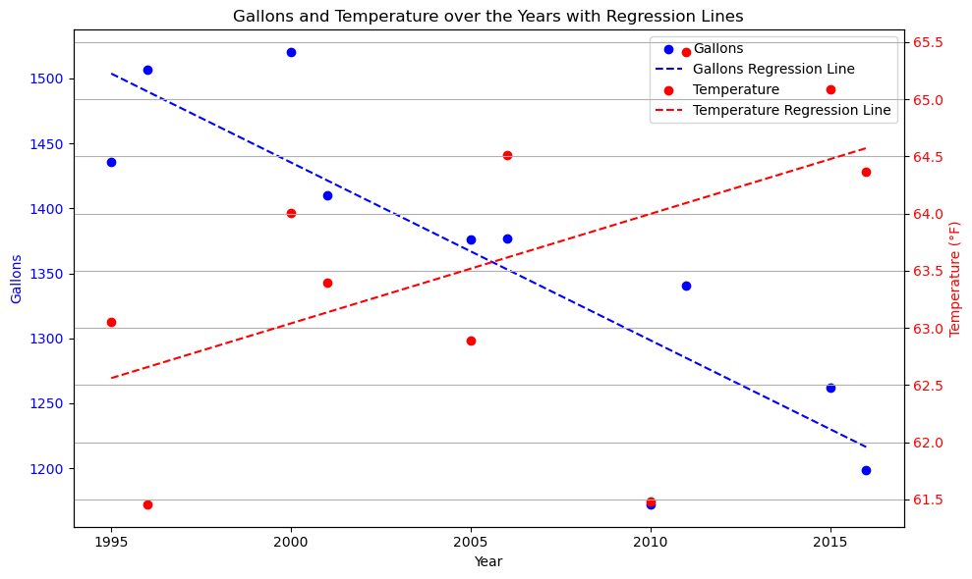
Correlation between Temperature and production
Over the years correlation between temperature and Production
Notes:
Correlation for the entire world is very difficult to build.
Countries above the equator suffered more temperature changes than below equator
Over the years production might have increased simply due to better manufacturing practices
Few countries did match our hypothesis, i.e. As temperature and weather events became more sever, production went down.
The correlation graph here was made using the lingress method. This matched for the highest wine producing countries (France, Italy, etc.).
NULL Hypothesis – Australia and US did not show any correlation between production and weather. Probably due to very large area and specialized wine producing regions with favorable weather.
Alternate hypothesis – Countries like France showed decent correlation between Climate/weather and production.

Slide 17
References & resources
See the Read Me at: https://github.com/omomadcat/Viticulture

Slide 18

Thank you!
Q&A

